Slide 1

Prototype Proposal

Slide 2
Title of the prototype
Multi-Disease Detection System with X-ray images Using Deep Learning Techniques

Slide 3
Problem Statement
Many of the existing machine learning models for health care analysis is focusing on one disease per analysis. If a user wants to predict more than one disease, he/she has to go through different sites. There is no common system where one analysis can perform more than one disease prediction. Some of the models have lower accuracy which can seriously affect patients’ health. When an organization wants to analyze their patient’s health reports, they have to deploy many models which in turn increases the cost as well as time. Some of the existing systems consider very few parameters which can yield false results. The project aims to improve healthcare outcomes of multiple diseases by enabling early detection and prediction of diseases using machine learning and deep learning.

Slide 4
Paper Details
Authors : Prottoy Saha, Muhammad Sheikh Sadi, O.F.M. Riaz Rahman Aranya, Sadia Jahan, Ferdib-Al Islam
Title of the paper: COV-VGX: An automated COVID-19 detection system using X-ray images and transfer learning
Journal: Informatics in Medicine Unlocked
Volume: 26
Year of published: 2021
ISSN : 2352-9148

Slide 5

Beneficiary Domain
Healthcare

Slide 6
Technical Domains
01
02
Computer Vision
Deep Learning

Slide 7
AI Techniques
Convolutional
Neural Networks
Transfer Learning

Slide 8
Dataset Collection
Data Preprocessing
Convolution Neural Network
Transfer Learning
Performance Evaluation
Techniques
Strategies

Slide 9
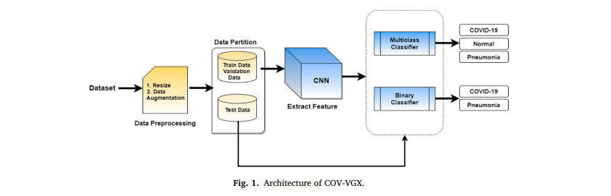
Architecture

Slide 10
Phase4: User interface & Testing
Phase3: Building the model & Training the model
Phase2: Experimental Setup & Model Selection
Phase-1: Data Collection & Data Preprocessing
Action Plan/Schedule

Slide 11


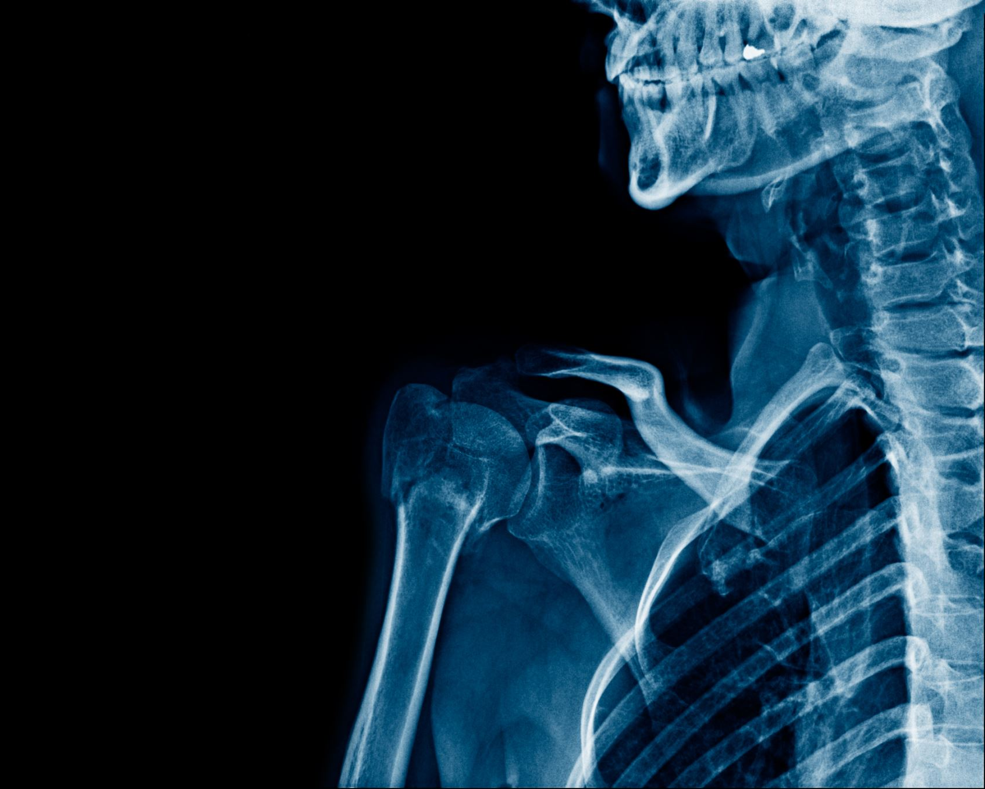
Proposal for Extending to Final Semester Project
We will be available with more and more data and try to make our models with more accuracy.
We will be adding more disease detections that can be detected.
In multiple disease prediction, it is possible to predict more than one disease at a time. So, the user doesn’t need to traverse different sites in order to predict the diseases.

Slide 12

Conclusion
COV-VGX, a crucial development, offers automated COVID-19 detection from X-ray images, aiding the strained healthcare system and potentially saving lives by accurate classification. Its deep feature extraction and classification capabilities contribute to efficient identification of COVID-19, pneumonia, and normal cases.

